Slide 1
Planetary Crisis
Unnatural Disasters 2017

Slide 2
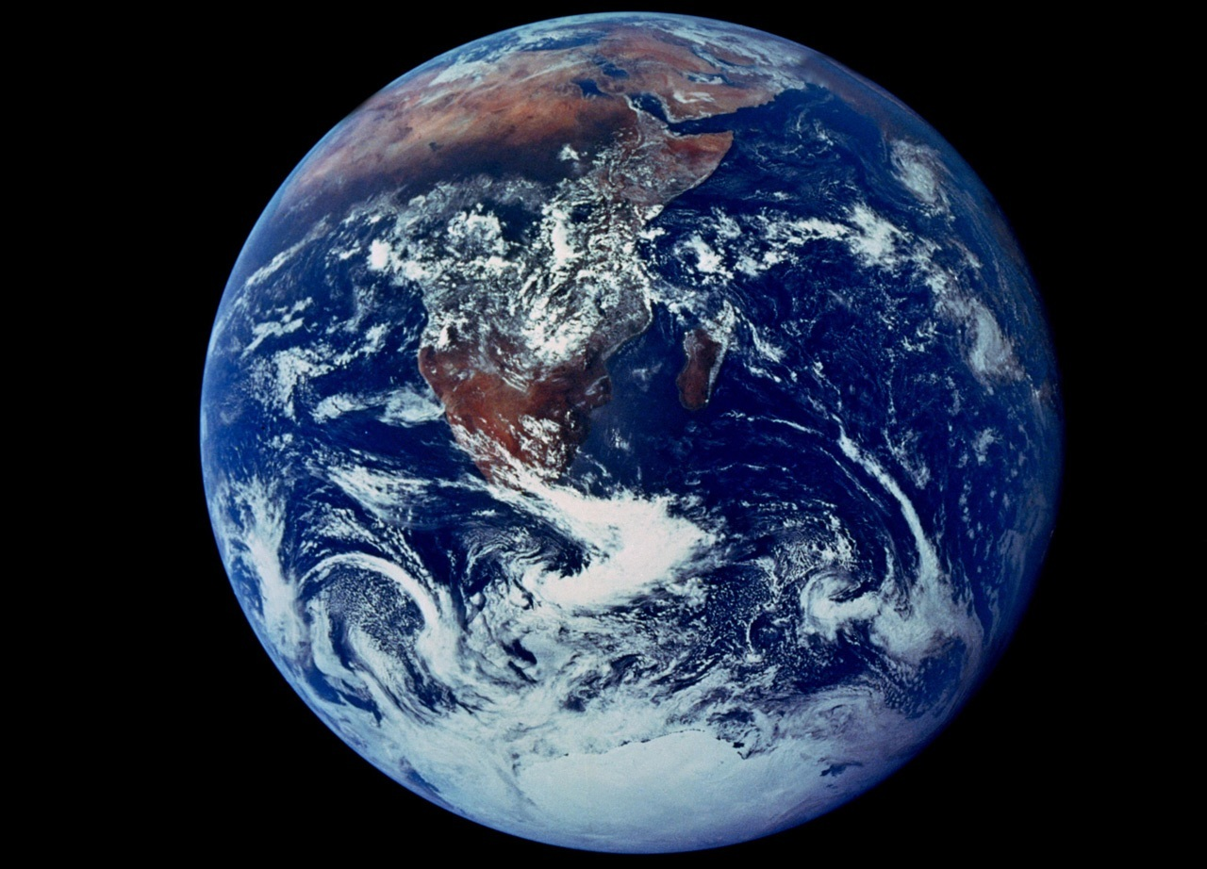

Slide 3
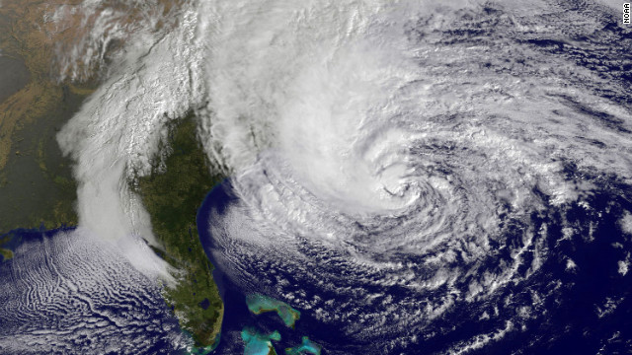

Slide 4
Are climate change risks ‘democratic’?

Slide 5
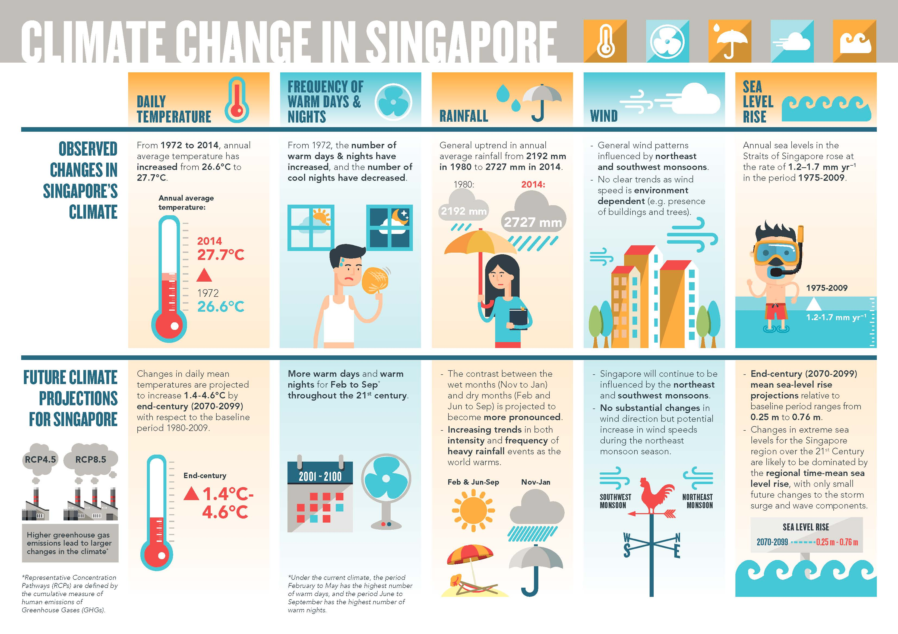

Slide 6
Singapore’s climate adaptation plans
What has been done?
What are the limitations?

Slide 7
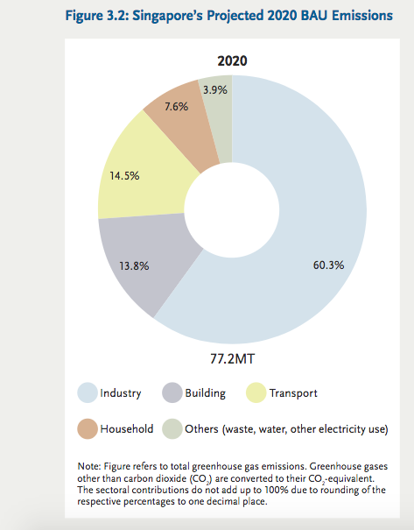
“Our refining and chemical industries are expected to contribute about half of Singapore’s 2020 BAU emissions.”
-NCCS 2012: 44.
“Singapore has pledged to reduce emissions by 16% below 2020 business-as-usual (BAU) levels if there is a legally binding global agreement in which all countries implement their
commitments in good faith.”
-NCCS 2012: 40.
2005: 41 million tons (NCCS 2012: 35)
2020 BAU: 77.2 MT
2020 with pledged reduction: 64.8 MT

Slide 8

‘Pluripotent’ climate futures

Slide 9
How should Singapore approach ‘pluripotent’ climate change futures?
What do you think is the key challenge to Singapore’s sustainability?

Slide 10
Can this challenge be addressed through urban or infrastructural design? How? Or, why not?

Slide 11
What concept or theory or example that we studied this term is most useful for preparing for this possible challenge to Singapore’s sustainability?

